Slide 1
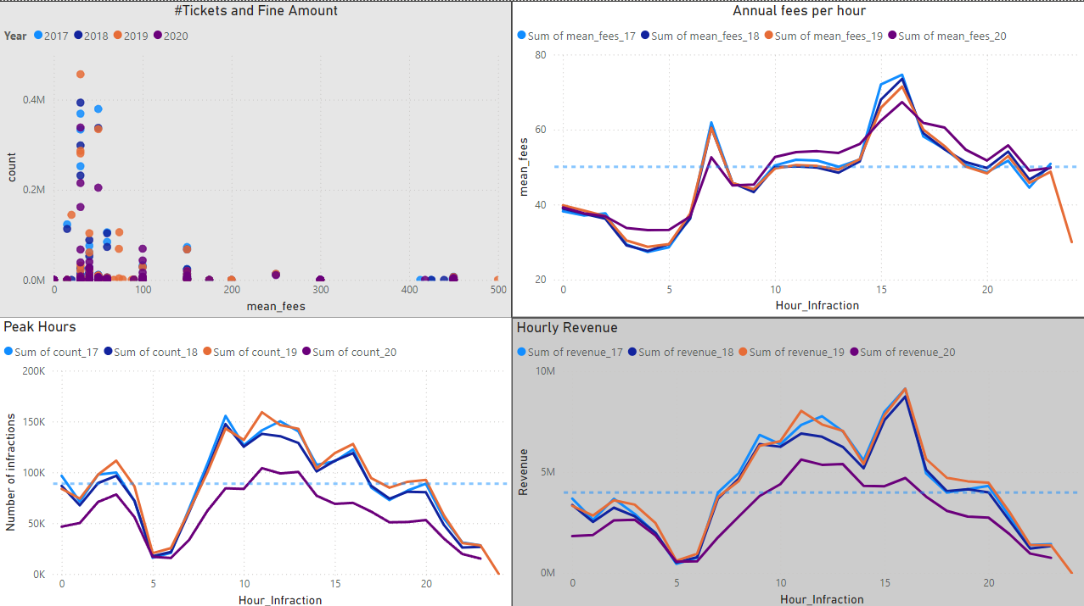
Does the fine amount matter? Judged by Fine trends.

Slide 2
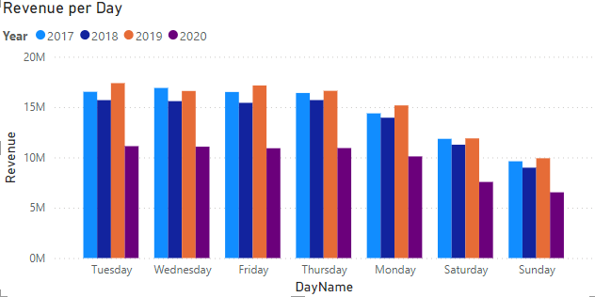
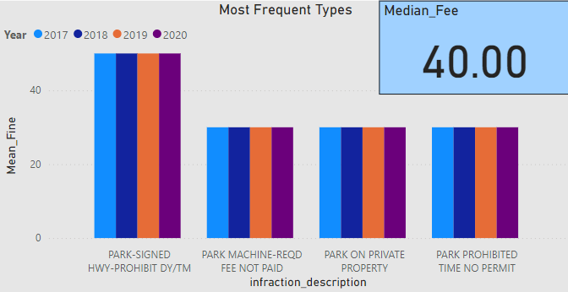

Slide 3
Negative correlation between number of tickets and average fine amount.
Peak hours -> revenue booms -> 4 pm max although not the busiest hour but has max fine amount!
Weekends have the least revenue.
Between 12 and 4 am, peak hours, but low revenue and very less fine amount – night life -> increase fee.
4 ticket types have always remained on top, with their fee amounts mostly below the median. Recommendation: need to improve signs warning about these tickets in the parking lots.

Slide 4
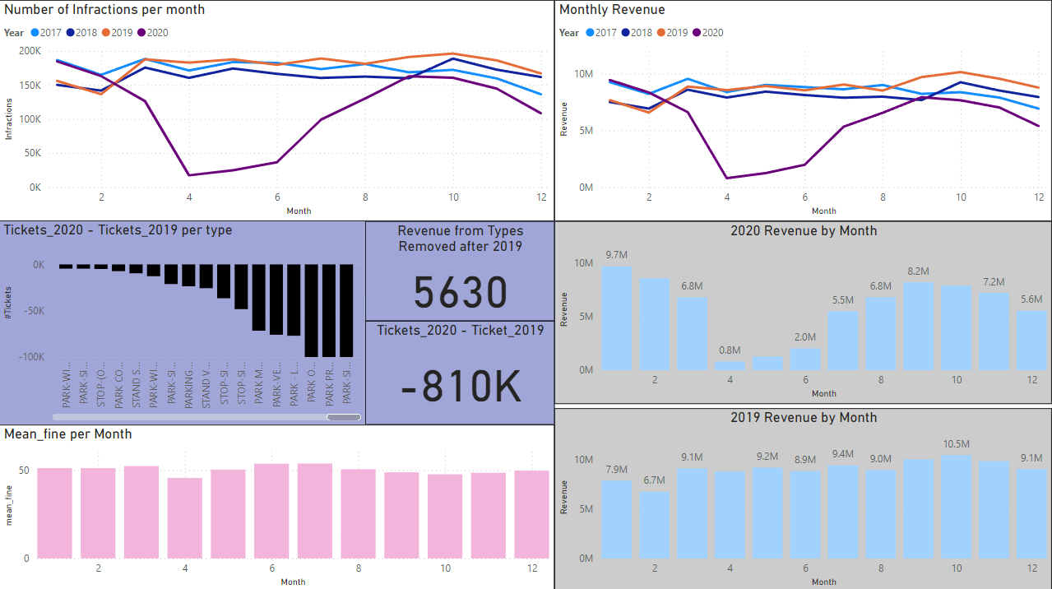
Revenue Trends

Slide 5
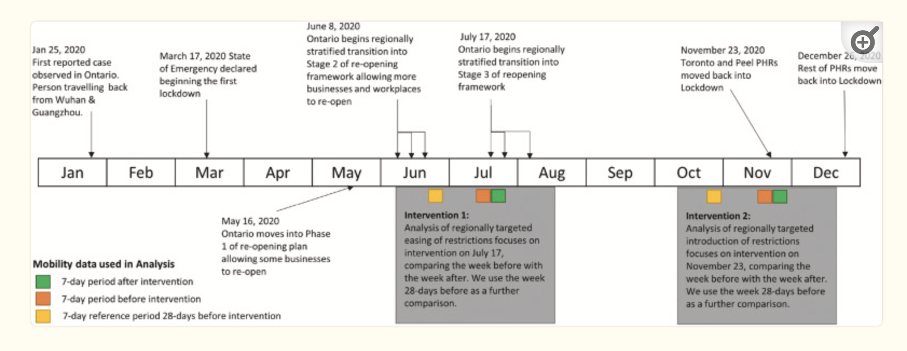
Revenue Trends
2020 observed a dip in revenue by nearly 40M.
The fine structure remained the same. 33 types of tickets from 2019 were removed in 2020.
They were removed due to low contribution to revenue. (about $5600)
Since there was no change in the two factors above, the overall reduction in revenue is associated with the pandemic – clear dip in revenue from April to June.

Slide 6
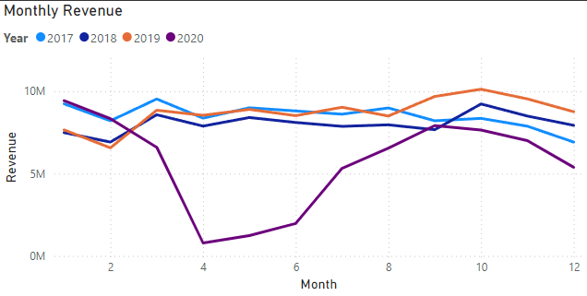
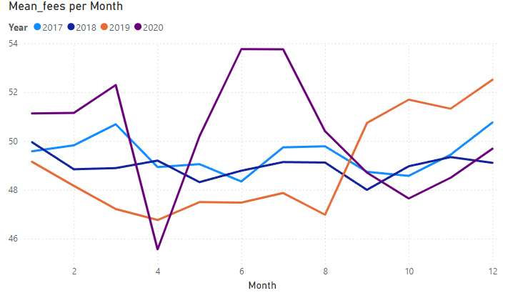
Revenue peaks in March consistently. It decreases after November, due to winter perhaps.
2018 and 2019 revenue picked up in September (October peak). The new ticket types (22 and 41 resp.), last warm months (10 degrees), and higher fine amount should be the contributing factors.

Slide 7
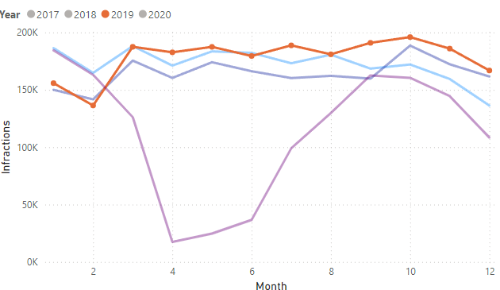
Another observation: fine amount goes up in December and falls in February – time of Christmas, New Years, Boxing Day.
2019 had a great revenue even when the average fee was lower than usual. Traffic was busier:
41 new types of infractions contributed 14K.

Slide 8
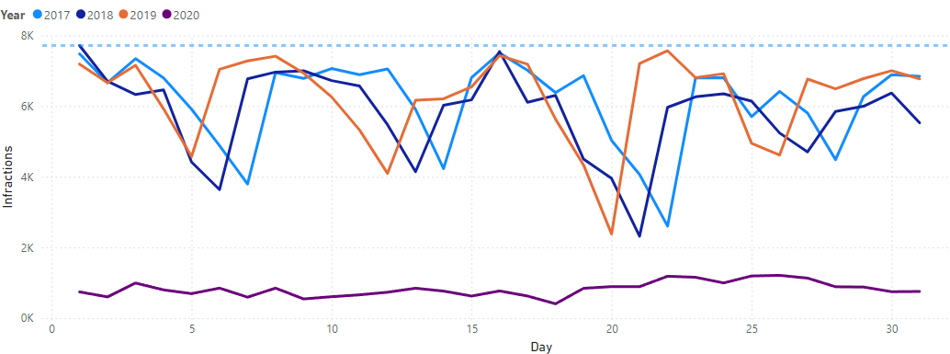
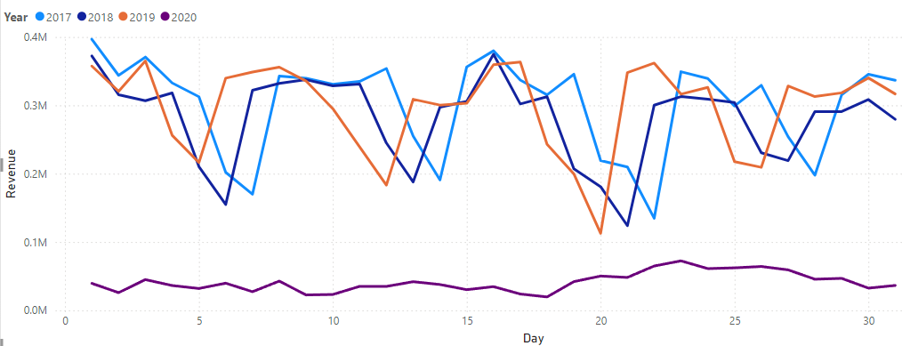
March hit maximum on St. Patricks every year

Slide 9
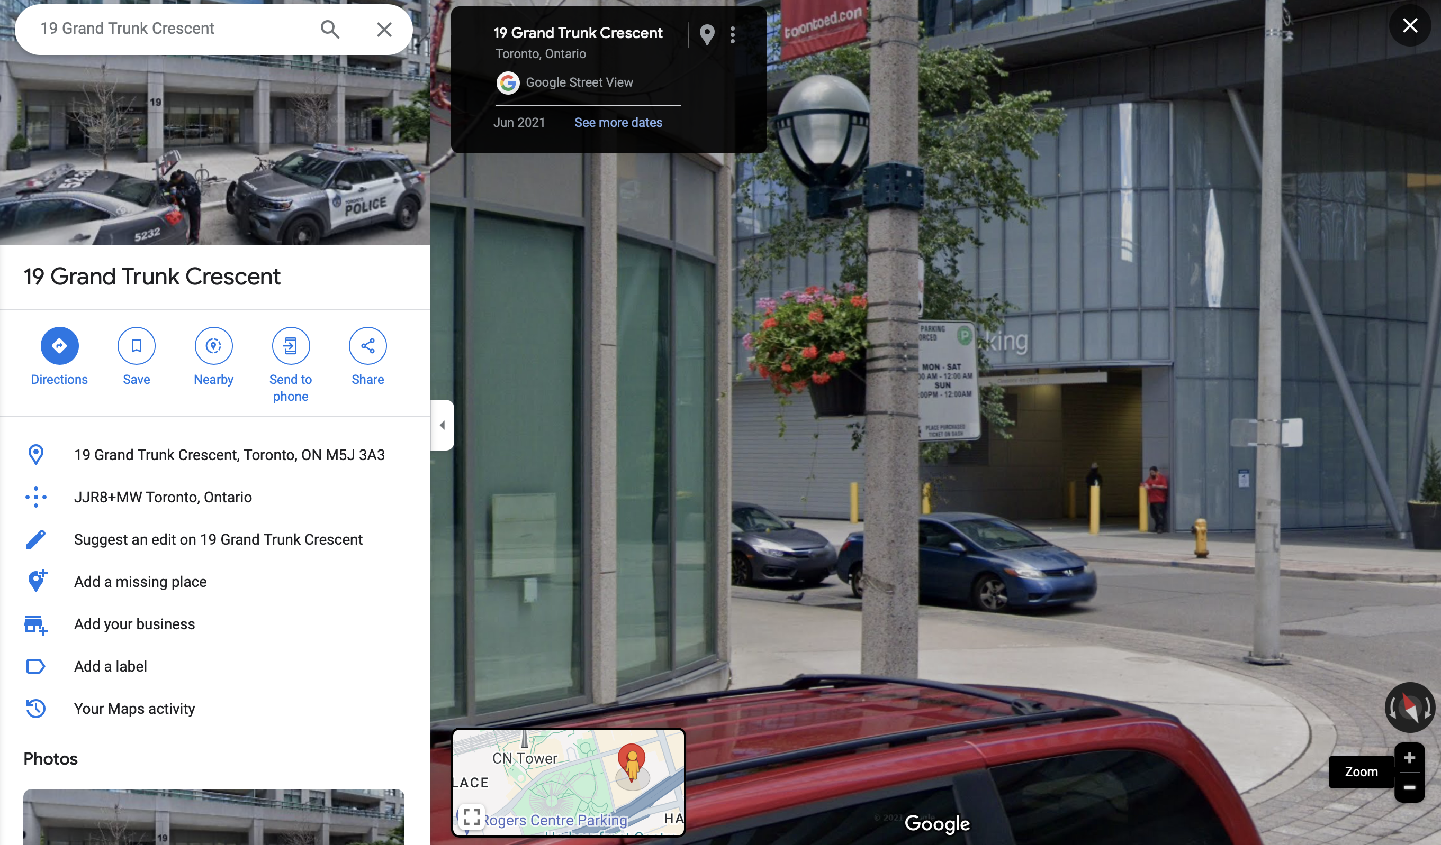
Recommendations
We can increase the fees to improve enforcement AND increase revenue! Price elasticity of demand can be used for threshold.
Night Life, Weekends, Most frequent tickets, 5am, occasions.
Improve signs Example:
19 Grank Trunk Crescent
Multi-Story Parking

Slide 10
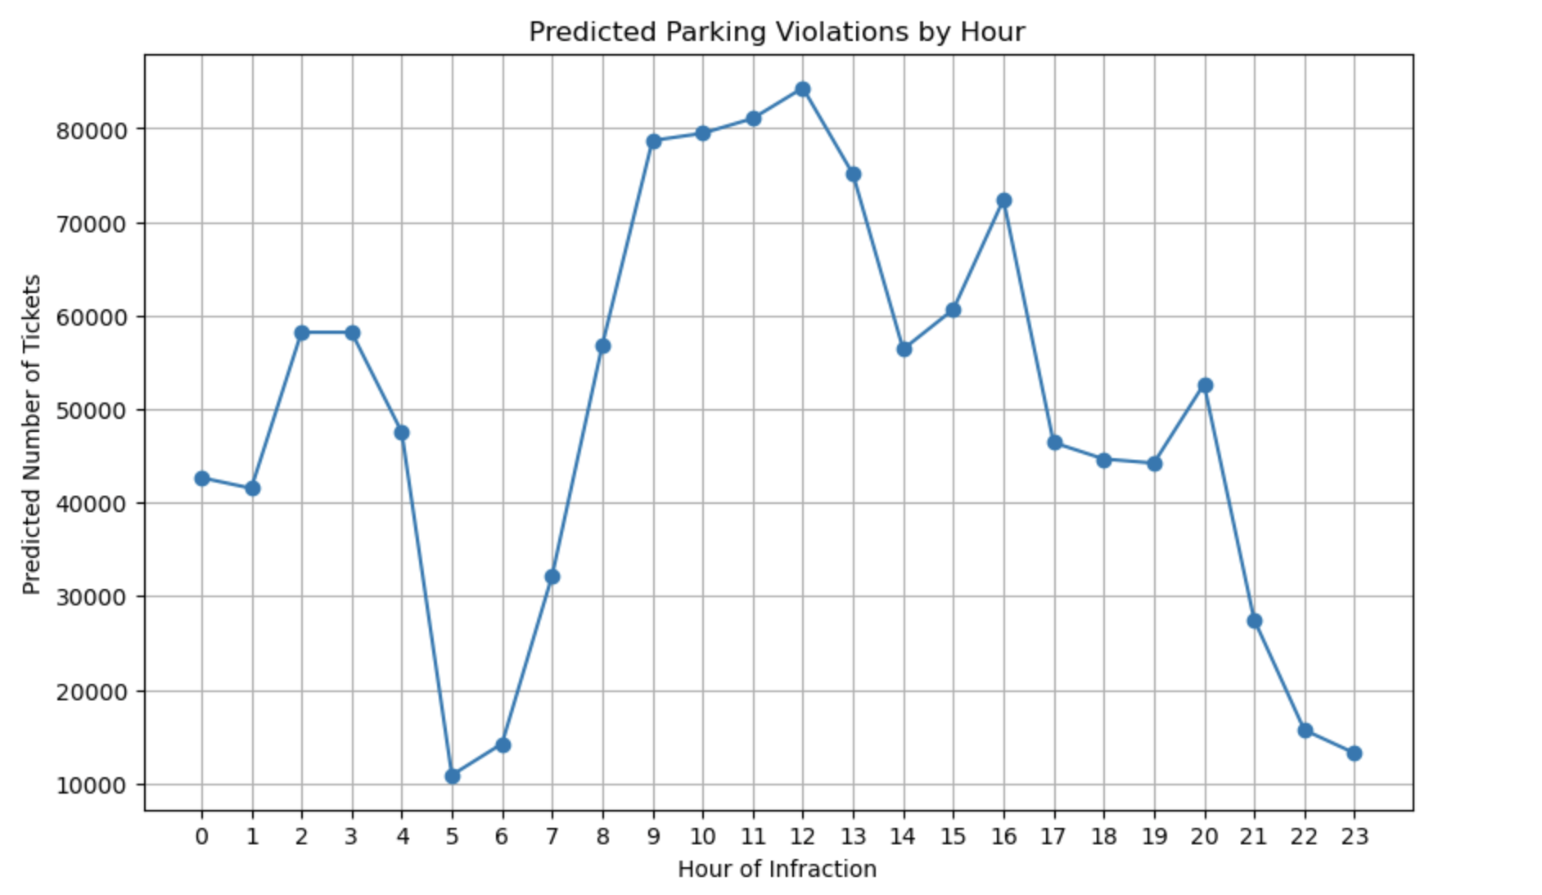
Growth rate in population in 2024 is 0.93%. So, more enforcement agents at forecasted peak hours. XGBoost Regressor, MSE 2900, currently tuning parameters. Considered 2021 due to the Hybrid nature post covid.

